Slide 1
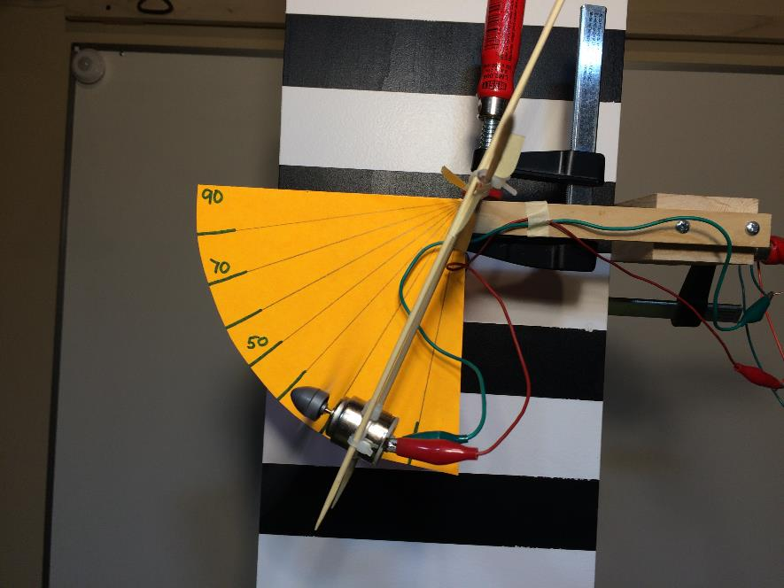
Propellers
Propeller Test Apparatus
LabRat Scientific
March 2018

Slide 2
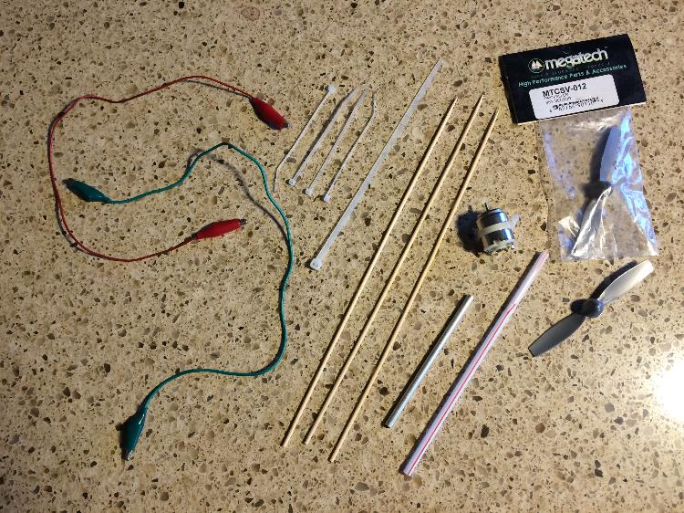
Materials Needed:
Wood skewers (3 ea)
Plastic Straw (or metal tube)
Nylon tie wraps
4 small
1 medium
Small DC electric motor
Propeller(s)
Power supply (or batteries)
Volt Meter
Assorted wire and alligator clips
2x4 wood (~24” in length)
C-Clamp

Slide 3
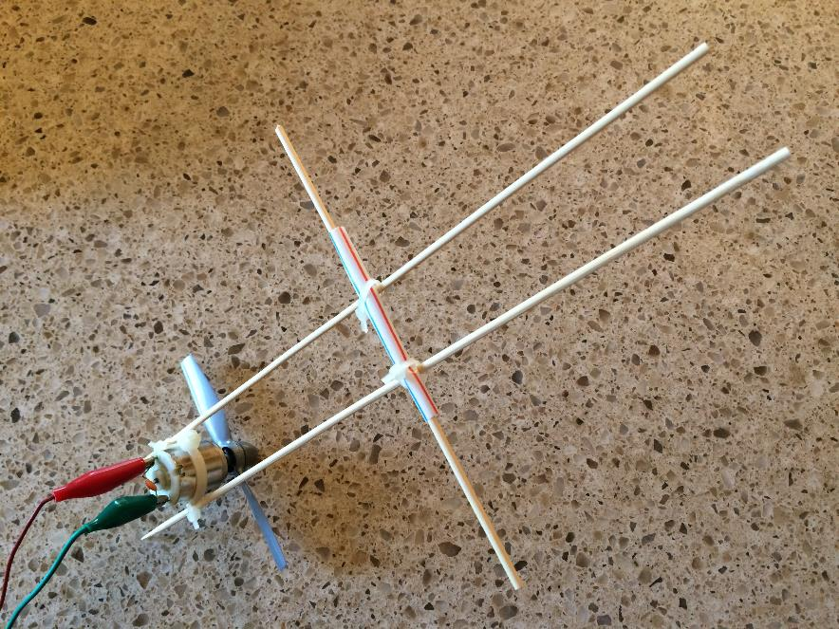
The Completed Test Apparatus
Wood Skewer to be mounted to support stand
DC Motor and Propeller
Plastic Straw hinge
Support structure – 2 wood skewers

Slide 4
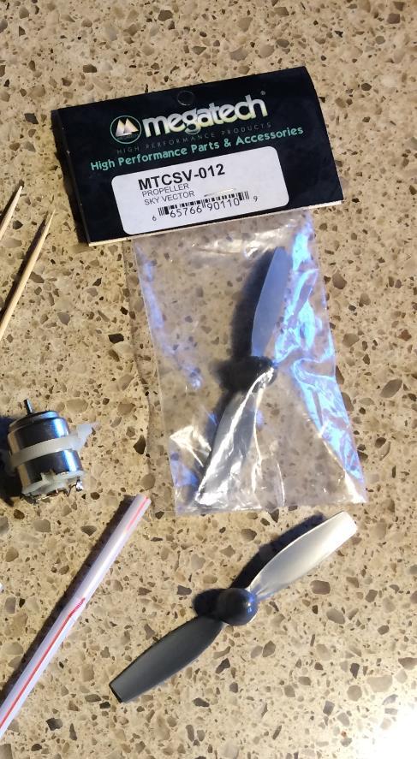
Propellers can be obtained from a local hobby shop or purchased on line.
If you purchase small propellers (~2” dia) the hole on the back of the propeller hub will likely be close to the diameter of the shaft on your motor.
If the hole is too small, a small drill bit can be used to make the hole larger. If the hole is too bug, scotch tape can be wrapped around the shaft to make the fit more snug.

Slide 5
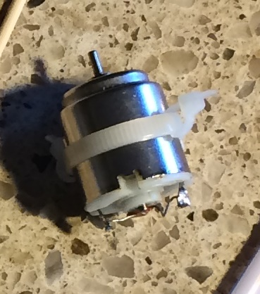
A small, round, can motor is ideal. One that is designed to operate at ~ 6 Volts DC is optimum. Can be removed from a old toy, obtained from a local electronics store, or bought on-line.
Secure the medium tie wrap around the motor. Cinch it up fairly tight but not completely.
Slip two small tie wraps under the one around the motor. Cinch these two closed, but not quite all the way. Wood skewers will be inserted into these small tie wraps.

Slide 6
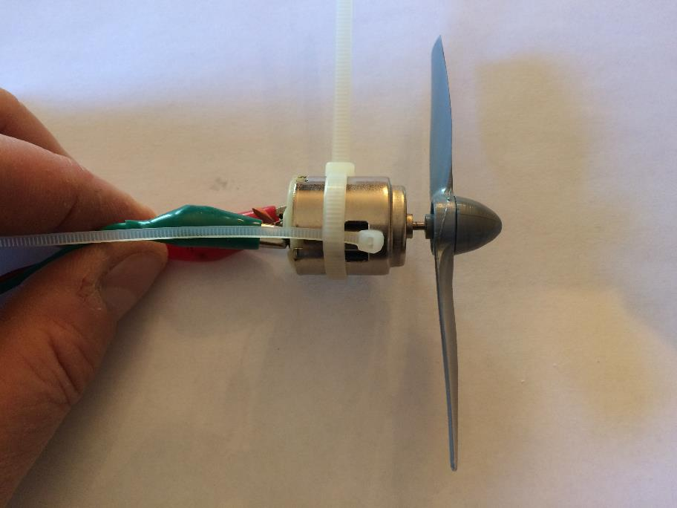
Small tie wrap installed before tightening

Slide 7
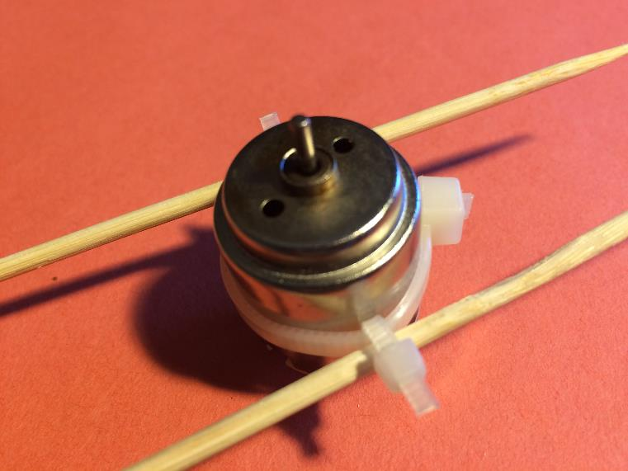
Once the skewers are installed, tighten all three ties wraps as tight as possible.

Slide 8
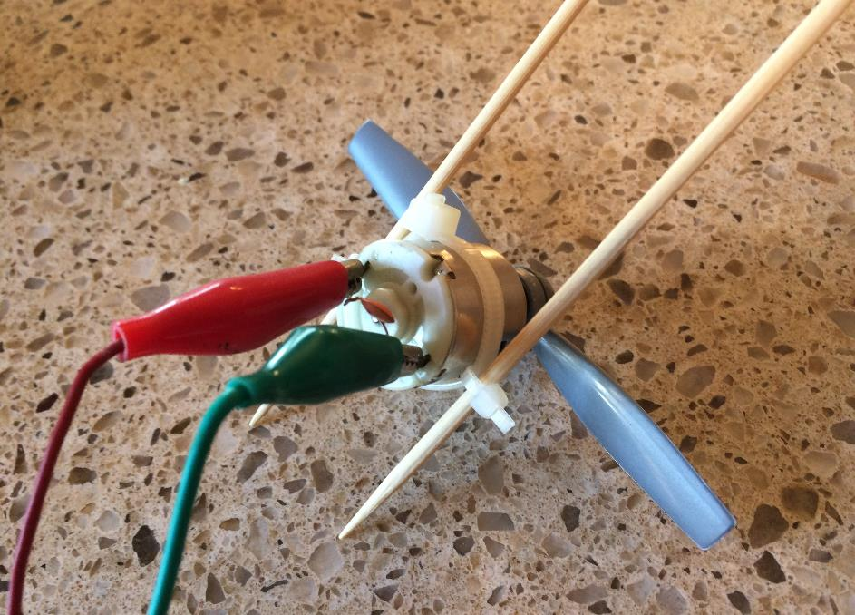
Skewers installed

Slide 9
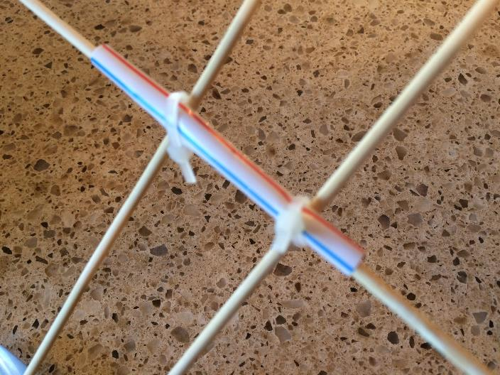
Cut a section of straw (or metal tube) about 2 inches long. Secure the straw to the two skewers that are attached to the motor. The skewers need to be tight to prevent the straw from slipping too easily, but not too tight such that the straw is crushed.
A thin walled metal tube (obtained from a hobby shop) is better than the plastic straw since it wont crush easily…

Slide 10
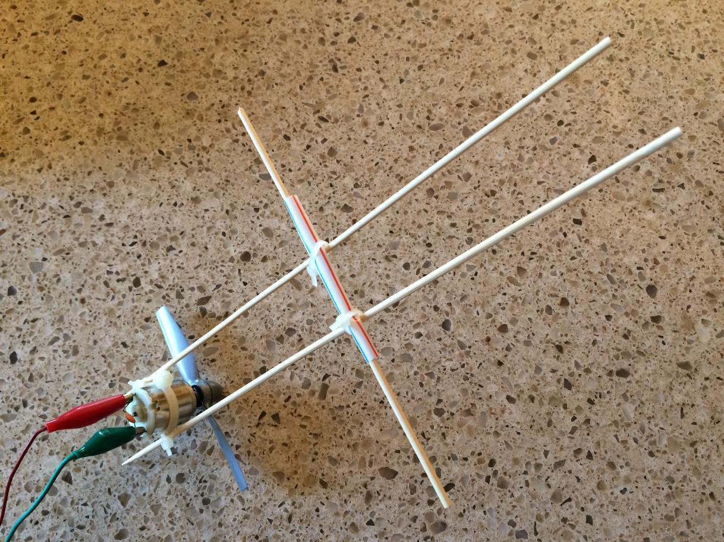
Fully assembled apparatus

Slide 11
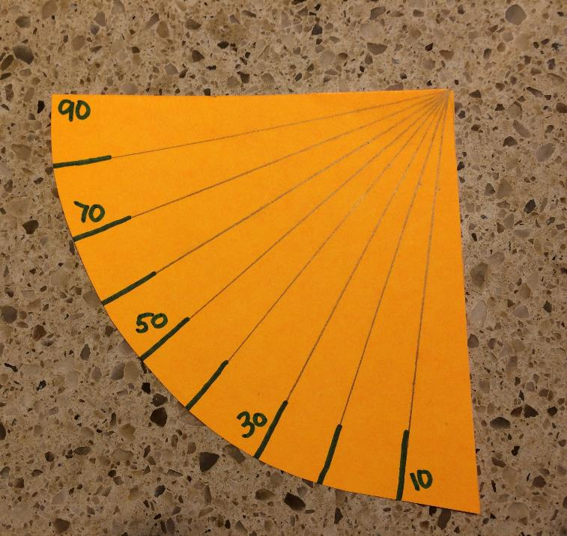
Make a deflection gauge using some stiff poster board. Use a protractor to mark the angles.

Slide 12
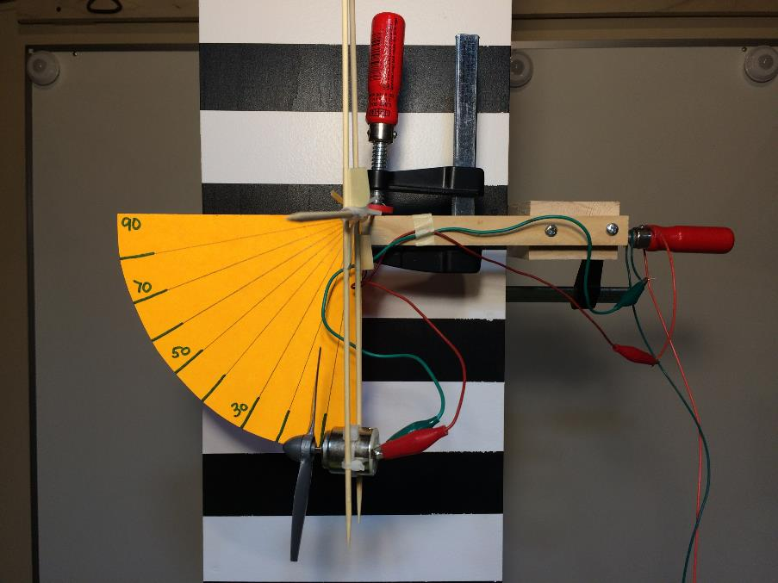
Here is the apparatus mounted to a stand. A simple 2x4 clamped to a work bench will work just as well. The horizontal skewer is clamped to the cross arm.
Position the deflection gauge so its origin it aligned with the horizontal skewer.

Slide 13
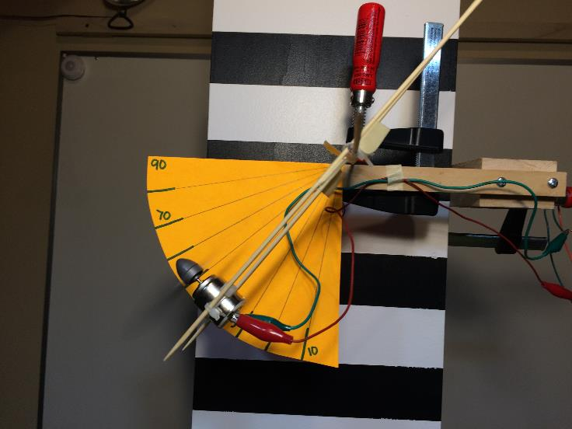
Deflection when 2.0 VDC is applied to the motor.
Deflection when 3.0 VDC is applied to the motor.

Slide 14
Calibration
When the motor is hanging at 0 Deg (straight down) the thrust is obviously zero. When the apparatus is deflected all the way to 90 Deg (horizontal) the thrust is equal to the system weight (motor + propeller + wires).
Forces associated with intermediate deflections can be calculated using the following formula:
Force = System Weight * Sin (deflection angle)

Slide 15
This apparatus can be used to test the thrust produced by propellers with different “blade pitches. It can also be used to test propellers with the same blade pitch but different diameters (a.k.a. actuator disk areas).

